Slide 1
CAPSTONE PROJECT 2
E-COMMERCE AI
INTELLIGENCE
PLATFORM
Purchase intent prediction • Hybrid product recommendations
ANN
RECOMMENDATION ENGINE
STREAMLIT
RETAILROCKET / PYTHON / TENSORFLOW

Slide 2
01 / WHY THIS MATTERS
The business problem
Low conversion
Anonymous behavior
Product discovery
Browsing activity rarely becomes a transaction.
Raw clicks hide buying intent.
Large catalogs make relevant items hard to find.
THE OPPORTUNITY
Turn customer behavior into timely predictions and relevant recommendations.
CP2 / E-COMMERCE AI
02 / 16

Slide 3
02 / WHAT WE BUILT
Project objectives
01 Predict
02 Recommend
03 Deploy
Estimate purchase within the next 24 hours.
Rank products using interactions and category similarity.
Make both models usable through an interactive website.
DEEP LEARNING
RECOMMENDATION
APPLICATION
ANN
HYBRID
STREAMLIT
CP2 / E-COMMERCE AI
03 / 16

Slide 4
03 / DATA FOUNDATION
RetailRocket dataset
CUSTOMER EVENTS
UNIQUE VISITORS
UNIQUE PRODUCTS
2.756M
1.408M
235,061
events.csv
item_properties × 2
category_tree.csv
Timestamp · visitor · event · item
Product properties and availability
Category-to-parent hierarchy
Historical activity: May–September 2015
CP2 / E-COMMERCE AI
04 / 16

Slide 5
04 / SOLUTION FLOW
End-to-end architecture
RetailRocket
Feature pipeline
ANN
Hybrid engine
Streamlit
→
→
→
→
Event + item data
Sessions + labels
Purchase intent
Top-N products
Interactive web app
Saved models + scaler + product metadata loaded by the website
CP2 / E-COMMERCE AI
05 / 16

Slide 6
05 / CLEANING & SESSIONS
Data preparation
Clean
Time features
Sessionize
Removed 460 exact duplicate events.
Converted millisecond timestamps to datetime.
New session after >30 minutes of inactivity.
TOTAL SESSIONS
SESSION GAP
ELIGIBLE ANN SESSIONS
1.762M
30 min
1.741M
CP2 / E-COMMERCE AI
06 / 16

Slide 7
06 / SUPERVISED LEARNING
Purchase intent target
TARGET = 1
Next transaction occurs within 24 hours after session end
NO PURCHASE
PURCHASE
POSITIVE CLASS
1,734,669
6,015
0.35%
Excluded sessions with a current purchase and incomplete 24-hour observation windows.
CP2 / E-COMMERCE AI
07 / 16

Slide 8
07 / ANN INPUTS
Feature engineering
Session activity
total_events · views · add_to_cart · unique_products
Time context
session_duration_minutes · session_hour · day_of_week · is_weekend · month
Customer history
previous_session_count · previous_purchase_count · hours_since_previous_session
12 INPUT FEATURES
CP2 / E-COMMERCE AI
08 / 16

Slide 9
08 / EXPERIMENTS
Model development
Logistic regression
Random forest
Neural network
Validation PR-AUC 0.1602
Validation PR-AUC 0.1953
Tuned validation PR-AUC 0.2058
CHOSEN MODEL
Tuned ANN 1 • 128 → 64 neurons • Adam learning rate 0.001
CP2 / E-COMMERCE AI
09 / 16

Slide 10
09 / NEURAL NETWORK
ANN design & optimization
INPUT
DENSE
DROPOUT
DENSE
DROPOUT
OUTPUT
→
→
→
→
→
12 features
128 · ReLU
0.30
64 · ReLU
0.20
1 · Sigmoid
Class weights
Early stopping
Threshold
Addressed the 0.35% positive rate.
Monitored validation PR-AUC.
Optimized on validation: 0.94.
CP2 / E-COMMERCE AI
10 / 16

Slide 11
10 / PREDICTIVE PERFORMANCE
ANN results on unseen test data
ROC-AUC
PR-AUC
PRECISION
RECALL
0.8833
0.2254
29.15%
37.12%
0.3265
F1 SCORE
Decision threshold: 0.94
Because the positive class is rare, PR-AUC and F1 are more informative than accuracy alone.
CP2 / E-COMMERCE AI
11 / 16

Slide 12
11 / RECOMMENDATION LOGIC
Hybrid recommendation engine
Behavior signals
Co-occurrence
Metadata rerank
View = 1 · Add-to-cart = 3 · Transaction = 5
Learn product pairs from training sessions only.
Same category ×1.20 · Same parent ×1.10
LIVE RECOMMENDATION
Exclude seen products → filter latest availability → rank Top-N
CP2 / E-COMMERCE AI
12 / 16

Slide 13
12 / CHRONOLOGICAL OFFLINE TEST
Recommendation evaluation
BEHAVIORAL
HYBRID
Hit Rate@5
25.48%
26.19%
Hit Rate@10
32.27%
33.21%
MRR@10
0.1682
0.1721
Coverage
88.22%
88.22%
Bonuses were compared on this offline evaluation period; it is not an untouched final holdout.
CP2 / E-COMMERCE AI
13 / 16

Slide 14
13 / INTERACTIVE APPLICATION
Streamlit deployment
Dashboard
Purchase intent
Recommendations
Performance
Project overview and dataset metrics.
12-feature form + ANN inference.
Top-N ranked products + availability.
ANN and recommender results.
MODEL ARTIFACTS
.keras + scaler.pkl + configs.json + neighbors.pkl + metadata.pkl
CP2 / E-COMMERCE AI
14 / 16

Slide 15
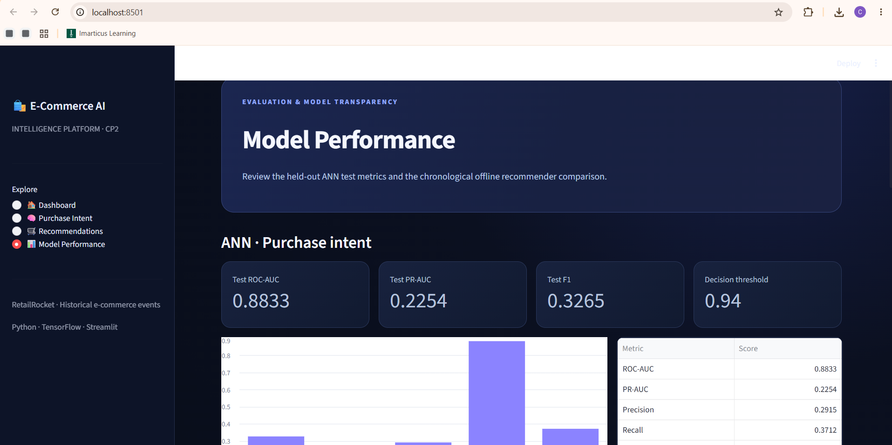
14 / FINAL INTERFACE
Live application preview
Dark-themed Streamlit model-performance view
CP2 / E-COMMERCE AI
15 / 16

Slide 16
15 / TAKEAWAYS
Conclusion & next steps
Built
Validated
Deployed
A working ANN + hybrid recommender platform.
Chronological splits and transparent evaluation.
Interactive local Streamlit application.
LIMITATIONS & FUTURE WORK
Anonymous product IDs · Historical availability · Final holdout · Product images
THANK YOU
CP2 / E-COMMERCE AI
16 / 16

